Slide 1
Practitioner Potpourri
Dr. Sean G. Boynes
Director of Interprofessional Practice
DentaQuest Institute

Slide 2
Team Proprietorship
Notes:
Which way does it move?
Bidirectional but need to know the care team regulations.

Slide 3
Permit holder – non permit holder policy:
If the permit holder travels to the offices of non-permit holders for the purpose of administering general anesthesia, deep sedation, conscious sedation or nitrous oxide/oxygen analgesia, the permit holder shall
Satisfactorily complete a clinical evaluation and the equipment transported to the non-permit holder dentist’s office
Shall satisfactorily complete an inspection conducted by an approved peer evaluation organization
As part of that clinical evaluation and inspection, the permit holder shall certify that each office location has the equipment required
The staff at each location shall be properly trained to handle anesthesia-related emergencies.

Slide 4
Auxiliary personnel who assist the permit holder in the administration of general anesthesia, deep sedation or conscious sedation:
Are trained to perform the duties that the permit holder delegates to them, if the duties do not require the professional judgment and skill of the permit holder and do not involve the actual administration of general anesthesia, deep sedation or conscious sedation.
Perform their duties under the direct on-premises supervision of the permit holder, who shall assume full responsibility for the performance of the duties.
Do not render assistance in areas that are beyond the scope of the permit holder’s authority.
Are currently certified in BLS.

Slide 5
PA Regulations - CRNAs
CRNAs who are delegated the duties of administering general anesthesia, deep sedation or conscious sedation:
Perform their duties under the direct on-premises supervision of the permit holder, who shall assume full responsibility for the performance of the duties.
Do not perform duties that are beyond the scope of the permit holder’s authority.
Are currently certified in ACLS.

Slide 6
The Schedule
Scheduling sedation care
Differences between care team members with sedation care have been observed; some team members struggle with care, especially with airway maintenance and maintaining a dry oral environment
Usually focus on a single day of sedation back to back as to optimize anesthesiologist schedule and production
Advantageous to have understanding of treatment plan and accurate prediction with operatory time
Difficult to manage other patients during sedation care
Impact to revenue?
Dental hygiene schedule?
Workforce needs?
Notes:
Use an associate or bring in dentist to keep hyg going

Slide 7
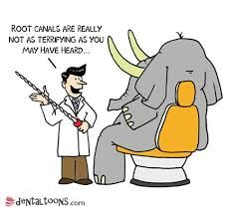
Questions and Discussion

Slide 8
The Pennsylvania Office Inspection
Office inspections and clinical evaluations shall be conducted in accordance with the AAOMS Manual and AAOMS Guidelines for OMSs and the ADA Guidelines and AAPD Guidelines for general dentists.

Slide 9
Equipment Needed at Site of Care
Moderate Sedation – internal cost and responsibility:
A positive-pressure oxygen delivery system suitable for the patient being treated must be immediately available.
When inhalation equipment is used, it must have a fail-safe system that is appropriately checked and calibrated.
The equipment must also have either:
(1) a functioning device that prohibits the delivery of less than 30% oxygen or
(2) an appropriately calibrated and functioning in-line oxygen analyzer with audible alarm.
An appropriate scavenging system must be available if gases other than oxygen or air are used.
The equipment necessary to establish intravenous access must be available.

Slide 10
The dental office in which the permit holder administers conscious sedation or nitrous oxide/oxygen analgesia on an outpatient basis contains the following:
(i) An operating room.
(ii) An operating table or chair.
(iii) A lighting system.
(iv) Suction equipment commensurate with the patient’s age, size and condition.
(v) Oxygen and supplemental gas delivery systems, including primary and back-up sources and a fail-safe control mechanism.
(vi) A sterilization area.
(vii) A recovery area.
(viii) A gas storage area and scavenger system.
(ix) Emergency airway equipment and medications, including intravenous emergency equipment.
(x) Communications equipment.
(xi) Patient transport equipment.
(xii) Monitoring equipment, procedures and documentation to conform to the age, size and condition of the patient and the AAOMS Manual and AAOMS Guidelines for adult and pediatric patients (OMS); the ADA Guidelines for adult patients (general dentists); and the AAPD Guidelines for pediatric patients (general dentists.)
(xiii) Pulse oximeter.
(xiv) ECG.
(xv) Blood pressure monitoring device.
(xvi) Defibrillator.
(xvii) Results of patient medical history and patient physical evaluation, and identification of anesthesia procedures to be utilized, prior to the administration of conscious sedation or nitrous oxide/oxygen analgesia.
(xviii) Signed, written, informed patient consent, prior to the administration of conscious sedation or nitrous oxide/oxygen analgesia, which includes a description of the procedure, its risks and possible alternative treatments. Consent for a minor patient shall be obtained from the minor’s parent or guardian.
(xix) Stethoscope.
Capnography

Slide 11
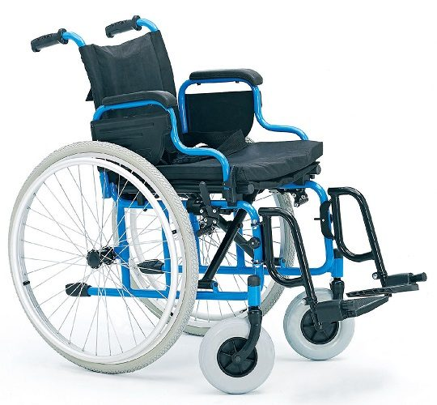
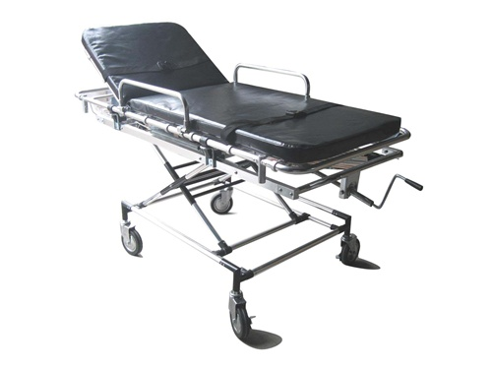
Patient Transport Equipment
Notes:
Discuss concept of recovery room and keeping operatory for next
Need at least a wheel chair even if leaving them in room

Slide 12
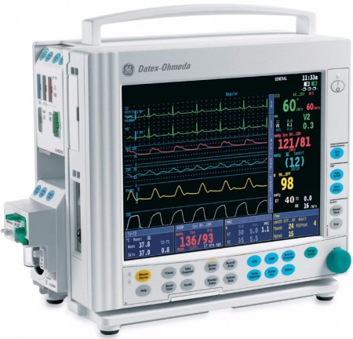
The Patient Monitoring Device
Notes:
Everyone on the team should know baseline values and where to find them

Slide 13
Defibrillator
Survival rates for sudden cardiac arrest victims can exceed 90 percent if defibrillation occurs in the first one to two minutes, but declines by about seven to 10 percent per minute for every minute thereafter.
After eight to 10 minutes, the survival probability is near zero.

Slide 14
Defibrillator
Successful dental office AED programs must ensure that operational AEDs can be rapidly retrieved when needed.
Each office/site should deploy a sufficient number of AEDs so that one can be retrieved and used within four to five minutes.
AEDs should be placed in known locations that are accessible to everyone. Inform everyone in the office of the locations of AEDs and place AED signs in proximity to each device. •Proper AED inspection and maintenance: AEDs are easy to maintain; however, each AED should be inspected at least monthly and serviced if needed. Batteries and electrodes that are within 90 days of expiring should be replaced.
•Sufficient number of AED responders: AEDs are safe and easy to operate by formally trained as well as untrained users.
Adequate AED response communications: Make sure that office staff members are able to rapidly communicate the need for an AED
Notes:
Situations involving locked, “invisible,” or otherwise inaccessible AEDs should be avoided
All employees and office visitors should know what AEDs are for and that they are easy to use.
AED maintenance
Training
Physician supervision
Agency notification
Program documentation

Slide 15
Oversight and Defibrillator Use
AED maintenance
Training
Physician supervision
Agency notification
Program documentation

Slide 16
Commonly Used Anesthetic Agents
Benzodiazepines (Valium – Midazolam –Triazolam)
Increases the efficiency of GABA to decrease neuron excitability
Sedative, amnestic
Associated with oral sedation procedures
Opioids (Morphine – Fentanyl – Demerol – Remifentanil)
Primary used to decrease pain experience, but have sedative properties
Effects on the respiratory system – respiratory depression
Non-barbiturate sedative (Propofol)
Potentiation of GABA receptor activity
Quick in and Quick out
For dental care administration - infusion pump
Anti-inflammatory agent (Ketorolac)
Associated with post operative pain management
Usually administered at beginning of sedation appointment
Concerns with bleeding in some patients
Notes:
Mention need to continue to use local anesthetics
Benzos - This reduces the communication between neurons and, therefore, has a calming effect on many of the functions of the brain.
Propofol thereby slowing the channel-closing timeand also acting as a sodium channel blocker – don’t really use brevital anymore
Corticosteriods like solu medrol.

Slide 17
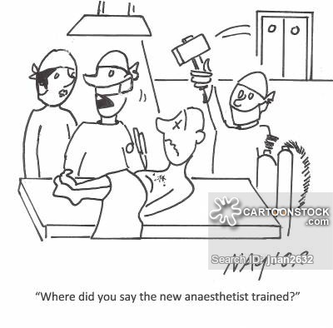
Questions and Discussion

Slide 18
Coding and Misconceptions
Notes:
Which way does it move?
Bidirectional but need to know the care team regulations.

Slide 19
Coding with Confidence
Dental Coding Guide
Provides information on
Appropriate use of coding
Documentation
Auditing/billing markers

Slide 20
Typical Coverage Parameters
The member is a child, up to 6 years old, with a dental condition that requires repairs of significant complexity; or
Members who exhibit physical, intellectual, or medically compromising conditions, for which dental treatment under local anesthesia, with or without additional adjunctive techniques and modalities, cannot be expected to provide a successful result; or
Members who are extremely uncooperative, fearful, unmanageable, anxious, or uncommunicative members with dental needs of such magnitude that treatment should not be postponed or deferred and for whom lack of treatment can be expected to result in dental or oral pain, infection, loss of teeth, or
Members for whom local anesthesia is ineffective (such as due to acute infection, anatomic variations or allergy); or
Members who have sustained extensive oral-facial and/or dental trauma; or
Members with bony impacted wisdom teeth.
Notes:
Something to think about is that this requires pre authorization. Who is response for that and who picks up the cost?

Slide 21
Dental Coding
When submitting anesthesia charges to a dental insurance carrier, the following CDT codes should be used:
D9223 (Deep sedation/general anesthesia — each 15 minute increment)
D9230 (Inhalation of nitrous oxide/analgesia, anxiolysis)
D9243 (Intravenous moderate [conscious] sedation/analgesia — each 15 minute increment)
D9248 (Non-intravenous conscious sedation)
Procedure code D9248 is a benefit when provided in the office setting. Providers must comply with all relevant rules and American Academy of Pediatric Dentistry (AAPD) guidelines, including maintaining a current permit to provide non-IV conscious sedation.
Notes:
Documentation supporting medical necessity and appropriateness for the use of non-IV conscious sedation must be maintained in the client’s record and is subject to retrospective review. (Esp. important if sharing billing with medical who may only be familiar with CPT coding)
Talk about time tracking

Slide 22
Anesthesia Administration and Coding
Does see waste and fraud abuse claims:
Fraud usually associated with time of care – over charging units
Poor documentation
Lack of informed consent
Improper use of codes
D9223 versus D9243

Slide 23
Dental Care Coding with Anesthesia Administration
There are instances where the diagnosis of disease and subsequent treatment determine the necessity for sedation care
Treating dentist responsible for the administration of the treatment plan in its entirety

Slide 24
Sedation and Oral Surgery
Inconsistent definition with use
D7210 vs. D7140
Review appropriate documentation of surgical extractions (Why and How)
Coding of procedure also at issue
Multiple extraction codes that can be difficult to decipher for auxiliary input
Procedure that only the dentist provider can ledger completed treatment for oral surgery procedures
Notes:
Mention that one site was losing substantial money when auxiliaries inputed extraction as 7140 – thought there was one code for extraction only.

Slide 25
Sedation and Oral Surgery
Standard (D7140) versus Surgical (D7210) extraction
If an erupted tooth removal requires laying a flap and removal of band and/or section of tooth, then report D7210 instead of D7140
Accurately describe the procedure and make clinical notes with “elevated flap and removed bone and/or section of tooth” for removal noted. If sectioned, a photo of the sectioned tooth can be uploaded into the patient’s record for future proof of treatment.
Keep in mind that procedure counts for D7210 are generally a fraction of the routine extraction D7140 counts.

Slide 26
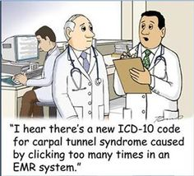
Questions and Discussion

Slide 27
TORT and Malpractice Coverage Implications
Notes:
Which way does it move?
Bidirectional but need to know the care team regulations.

Slide 28
Before doing anything it is always a must to check with your project officer, HRSA official, and/or check in with the PACHC.

Slide 29
What is TORT?
The Federally Supported Health Centers Assistance Act of 1992 and 1995 granted medical malpractice liability protection through the Federal Tort Claims Act (FTCA) to HRSA-supported health centers.
Under the Act, health centers are considered Federal employees and are immune from lawsuits, with the Federal government acting as their primary insurer.
Deemed Health Center Program grantees are immune from medical malpractice lawsuits resulting from the performance of medical, surgical, dental, or related functions within the approved scope of project.

Slide 30
So, are we covered?
Is this going to be part of your scope?
Sliding fee for services
How are patients selected?
Uninsured versus underinsured versus insured
Outsource / Insource
Third party expected to have own coverage
BAA in place with third party – equipment affidavit
Credentialing process
Lack of specialty status and operator anesthetist
Accreditation
Will impact the cost and possibly require building remodeling
JCAHO would expect ambulatory surgical center guidelines followed
Notes:
JCAHO facility fee – recovery area

Slide 31
FTCA Coverage – The sub-recipient???
The sub-recipient
Defined as an entity (not an individual contractor) that receives a grant or a contract from a deemed health center to provide the full range of health services on behalf of the deemed health center and only for those services under the scope of the project.
Sub-recipients can be eligible for FTCA coverage. Contractual relationships with other entities for individual services (e.g., laboratory, pharmacy, physician services) are not subject to FTCA coverage.”
A sub-recipient must also be identified as a part of the health center’s approved scope of project
Notes:
Seen sub receipient as part of anesthesiology services; does not apply!!!!

Slide 32
Quality Events and Adverse Occurrences
After statistical analysis, the overall complication rate of anesthesia administered during dental care was 22.4% in 286 cases.
Separating the complications into three severity categories (mild, moderate, and severe), found that 90.6% of the complications were considered mild and 9.4% were considered moderate.
No reports of severe complications transpired and no patients required hospitalization or emergency room treatment.
Boynes SG. Gen Dent. 2010; 58:e20-25
Notes:
Mild complications: Any occurring complication that resolved during the course of standard anesthetic care or those complications not requiring non-routine anesthetic management.
Moderate complications: Any occurring complication that resolved in an immediate manner following non-routine anesthetic treatment.
Severe complications: Any occurring complication that resulted in extensive pharmacological treatment; death; initiation of emergency medical management; hospitalization; and / or emergency room visitation.

Slide 33
Overall Complication Rate
Of the 286 analyzed cases:
upper airway support (airway obstruction) (6.3%)
nausea/vomiting (4.2%);
hypotension (2.8%);
hypertension (2.8%).

Slide 34
Overall Complication Rate
Variables found to affect the incidence of anesthetic complications are
ASA classification,
anesthetic technique,
pre-existing medical findings,
type of dental procedure performed.

Slide 35
Overall Complication Rate
The highest percentage of complications seen, within the 286 anesthetics, occurred in the following patient groups:
ASA status II patients (14.7%);
those undergoing oral surgery procedures (17.1%);
patients with a Mallampati III classification (9.4%);
patients with a pre-existing medical condition (17.5%)
those receiving intravenous sedation (15.7%).

Slide 36
Complications and Anesthetic Type
N=12
Mild Complications
Moderate Complications
N=170
N=35
N=32
N=37
Percentage

Slide 37
Complications/Anesthetic Type
Intravenous Sedation
Most Frequently Reported Complications
Airway Obstruction (26.7%)
Nausea / Vomiting (20.0%)

Slide 38
Complications/Anesthetic Type
GETA
Most Frequently Reported Complications
Hypotension (50.0%)
Sore Throat (25.0%)

Slide 39
Complications/Anesthetic Type
Nitrous Oxide AND Oral Sedation
Most Frequently Reported Complications
Tachycardia (50.0%)

Slide 40
Complications/Anesthetic Type
Oral Sedation
Most Frequently Reported Complications
Airway Obstruction (100%; N=8)

Slide 41
Summary
The assessment format paralleled the majority of research protocols used within the medical field to identify issues relating to anesthetic patient care.
The findings show that anesthesia administered during dental treatment is a safe and effective modality within the health care field.
The overall complication rate of 22.4% is similar or less than the rates reported through hospital based anesthesia practice.

Slide 42
Airway Obstruction
Hypoventilation and hypoxemia are associated with significant morbidity and mortality
Fundamental requirement in basic resuscitation and takes first priority for life support
Recognition
Knowledge of anatomy
Familiarity with airway devices
Oxygenation/Ventilation

Slide 43
Causes of Airway Obstruction
Upper Airway
tongue (due to unconsciousness)
soft tissue swelling
blood, vomit
direct injury
Larynx
foreign material, direct injury, soft tissue swelling
Lower Airway
secretions, oedema, blood
bronchospasm
aspiration of gastric contents

Slide 44
Recognition of Airway Obstruction
LOOK for chest/abdominal movement
LISTEN at mouth and nose for breath sounds and abnormal noises
FEEL at mouth and nose for expired air

Slide 45
Recognition of Airway Obstruction
Abnormal Sounds
Snoring - due to obstruction of upper airway by the tongue
Gurgling - due to obstruction of upper airway by liquids (blood, vomit)
Wheezing - due to narrowing of the lower airways
Complete airway obstruction is silent.

Slide 46
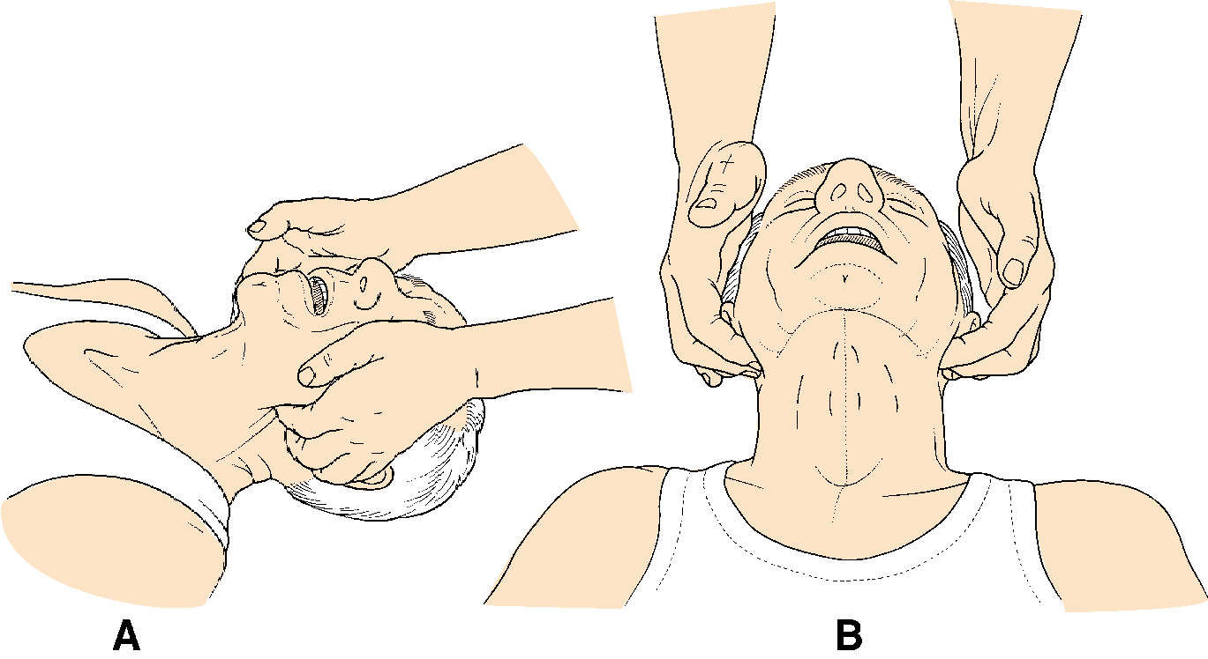
Opening the Airway
Jaw thrust
Suction
Head tilt
Chin lift

Slide 47
Airway Obstruction - Equipment
Face Mask
Provides a tight seal allowing greater tidal volume and accurate oxygen concentration to be delivered

Slide 48
Airway Obstruction - Equipment
Oral Airway
Curved device made of hard plastic
Placed into the mouth to relieve obstruction caused by a relaxed tongue
Keeps tongue from compressing against the posterior pharyngeal wall and serves as a bit block
Placement is contraindicated in the semiconscious patient since airway stimulation in this situation may result in patient laryngospasm
Dionne-Phero-Becker. Management of Pain and Anxiety in the Dental Office. WB Saunders New York, 2002.

Slide 49
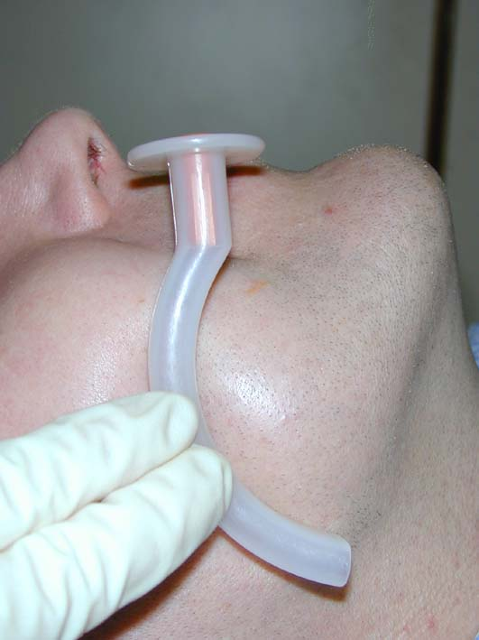
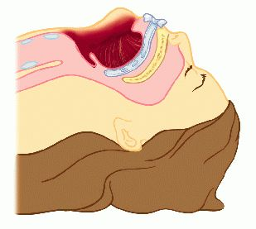
Airway Obstruction - Equipment
Oral Airway

Slide 50
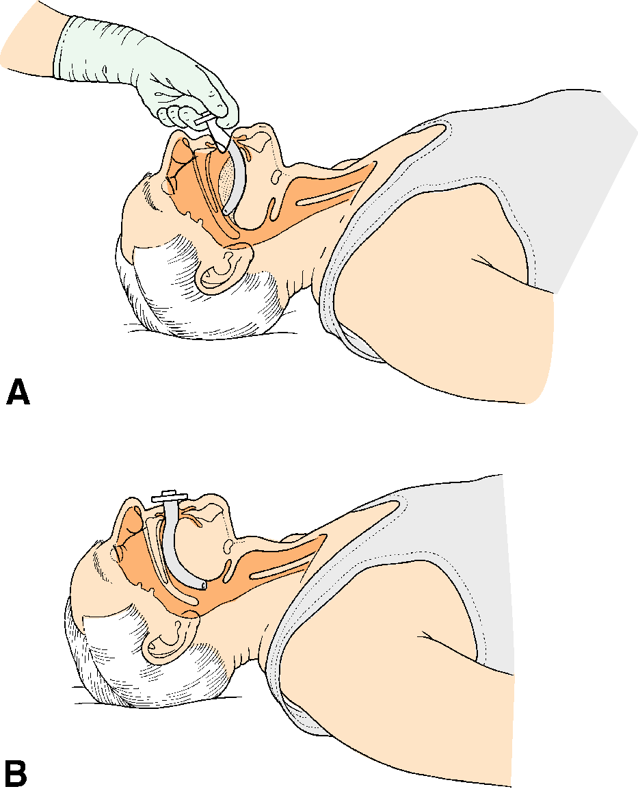
Airway Obstruction - Equipment
Oral Airway Insertion

Slide 51
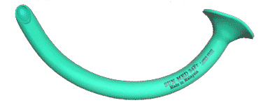
Airway Obstruction - Equipment
Nasal Airways (Trumpets)
May alternatively be used to accomplish the same goal as oral airways
May be more ideal method with dentistry
Made of soft plastic and placed in a single nare
Bleeding may occur

Slide 52
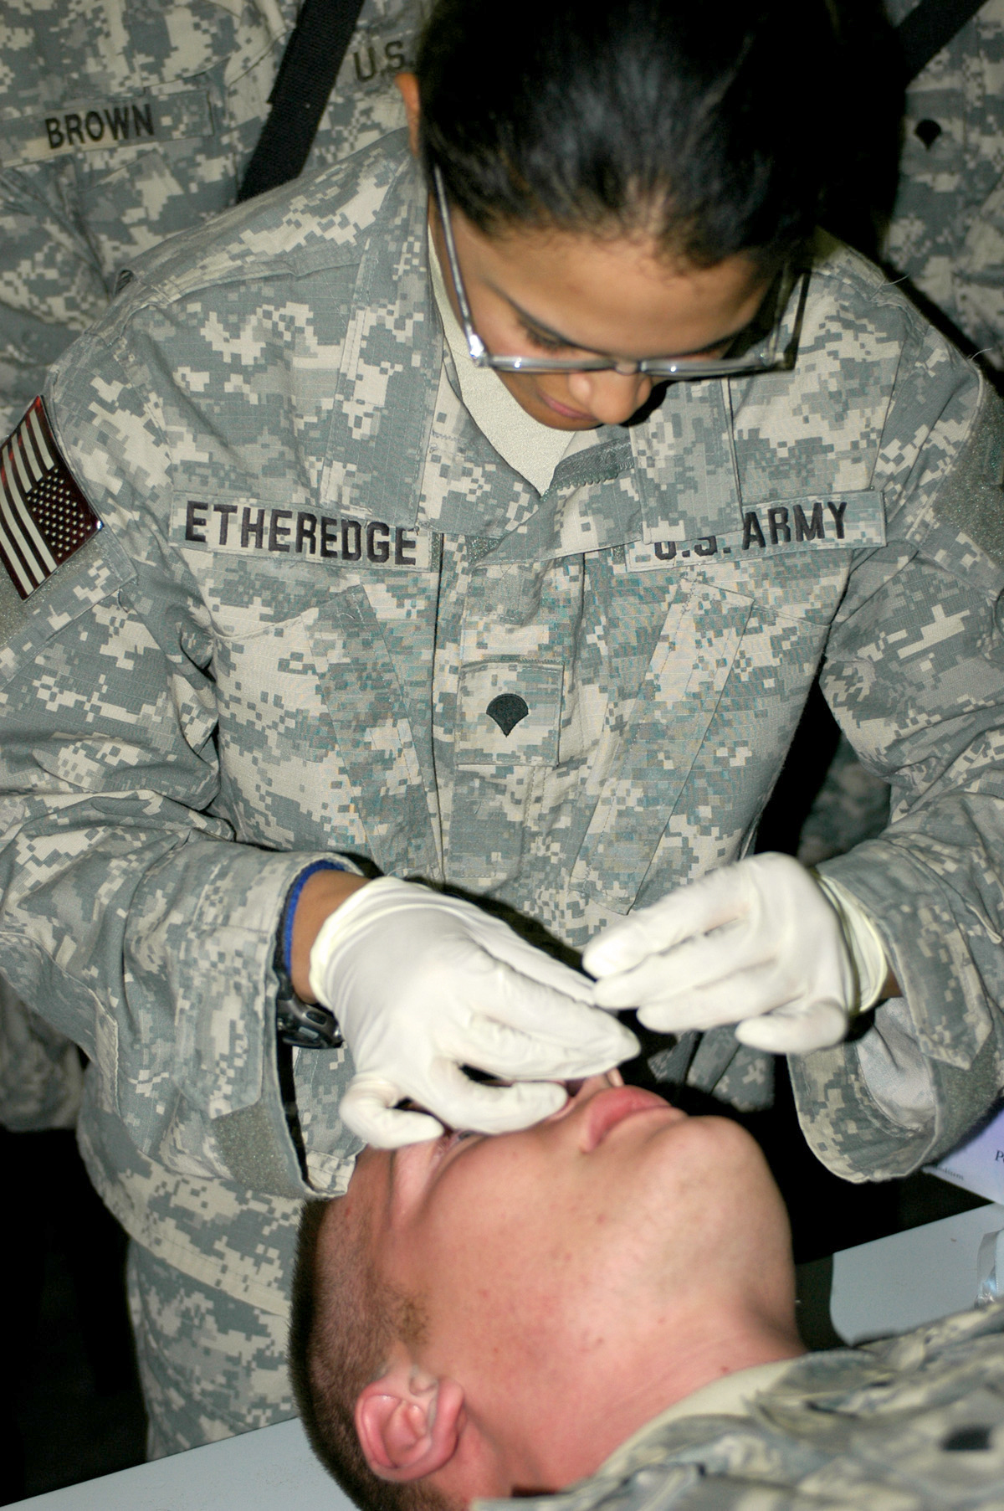
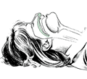
Airway Obstruction - Equipment
Nasal Airway

Slide 53
Airway Obstruction - Equipment
Endotracheal Tubes (ETT)
Polyvinyl plastic or latex tube placed into the trachea
Contains a cuff that occludes the tracheal lumen when inflated
Allows gas exchange to occur within the lumen of the ETT only

Slide 54
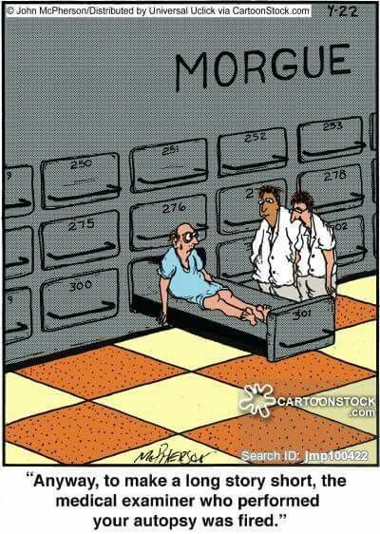
Questions and Discussion

